Slide 1
SWEN90016 Software Processes & Project Management
Individuals
and Teams
2019– Semester 1
Tutorial 4
Copyright University of Melbourne 2017

Slide 2

Today’s aim
Explore the relationships that exist between SDLC lifecycle models and team structures.

Slide 3

Roles: Manager and Leader
Power
Influence
What are the characteristics of each?

Slide 4
Team Roles
Consider the individuals in the team (10 mins)
Consider your own strengths and weaknesses
What roles might you play in your project team?
Initiator: offers ideas, solutions, brainstorm, lateral thinker Information seeker: wants facts Information giver: describes own experience, offers facts, clarification Coordinator: combine contribution of others Evaluator: assess quality of contributions Encourager: praising, accepting, cohesion and warmth Harmonizer: build consensus, humor to neutralize anger Standard setter: focus on goals, standards Follower: agreeable Group observer: provides feedback

Slide 5
Team Roles
What roles are necessary for a high functioning team?
Task
Maintenance
Destructive
Initiator:
Information seeker:
Information giver:
Coordinator:
Evaluator:
Encourager:
Harmonizer:
Standard setter:
Follower:
Group observer:
Blocker
Recognition seeker
Dominator: Free rider:
Avoider:
Lone wolf:
Reasonable combination

Slide 6
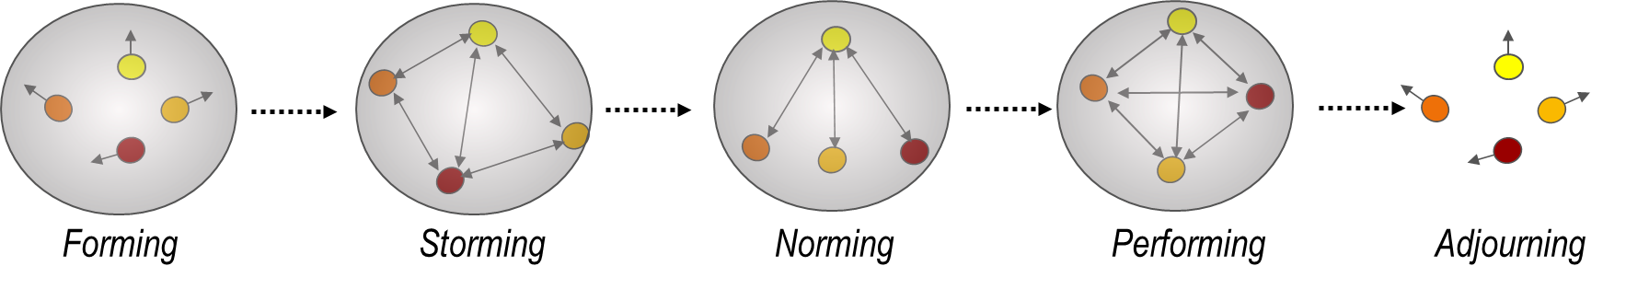
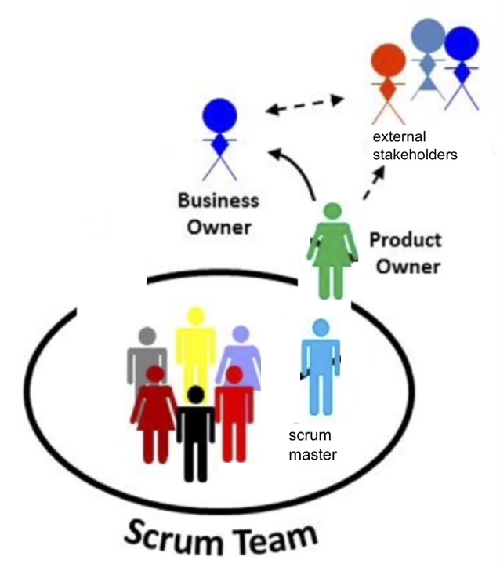
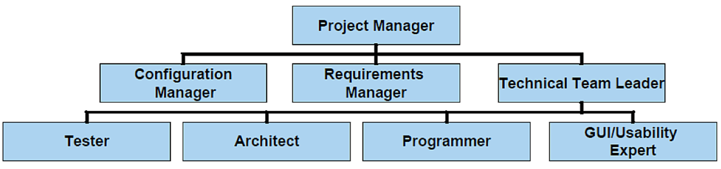
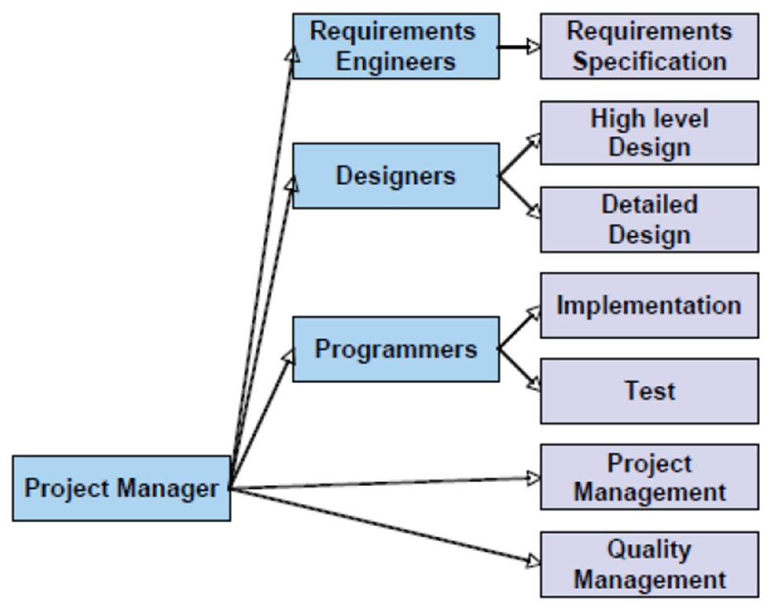
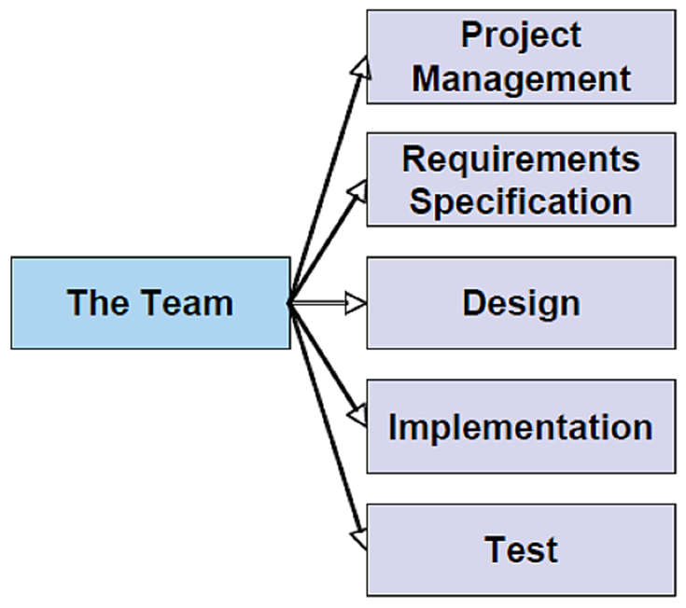
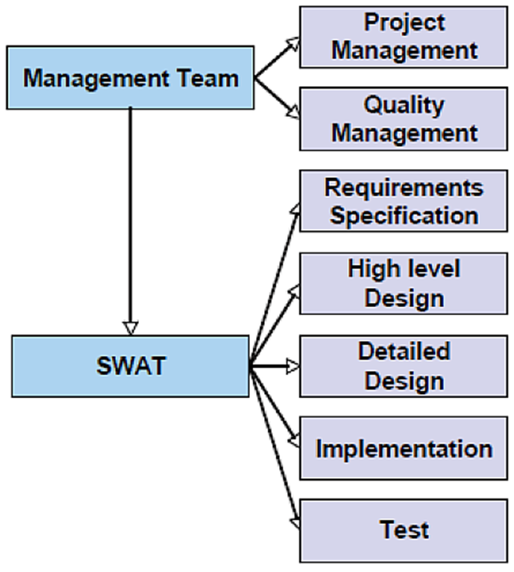
Teams
Team life cycle
from Lecture, slide 52
Team structures
from Lecture, slide 58-62
External
Stakeholders
scrum
master

Slide 7
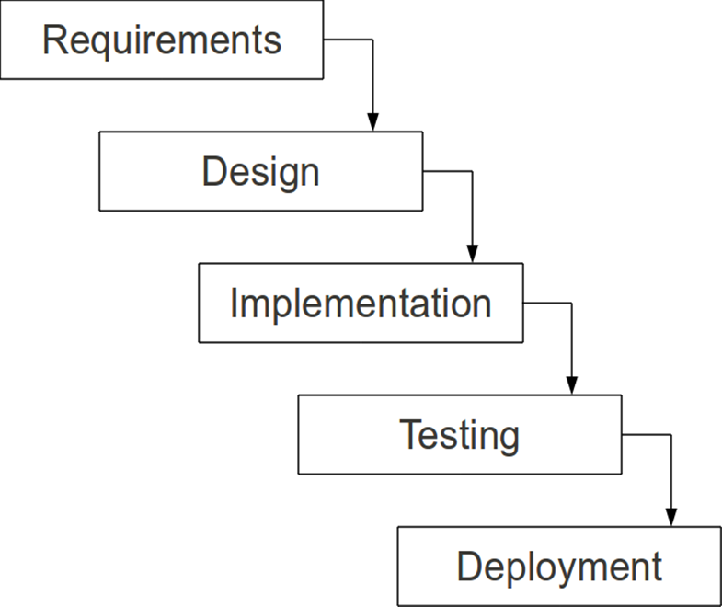
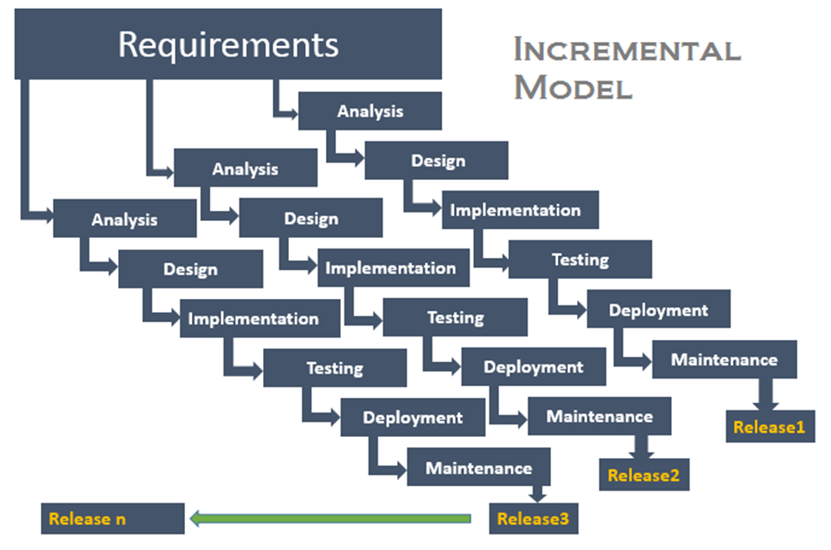
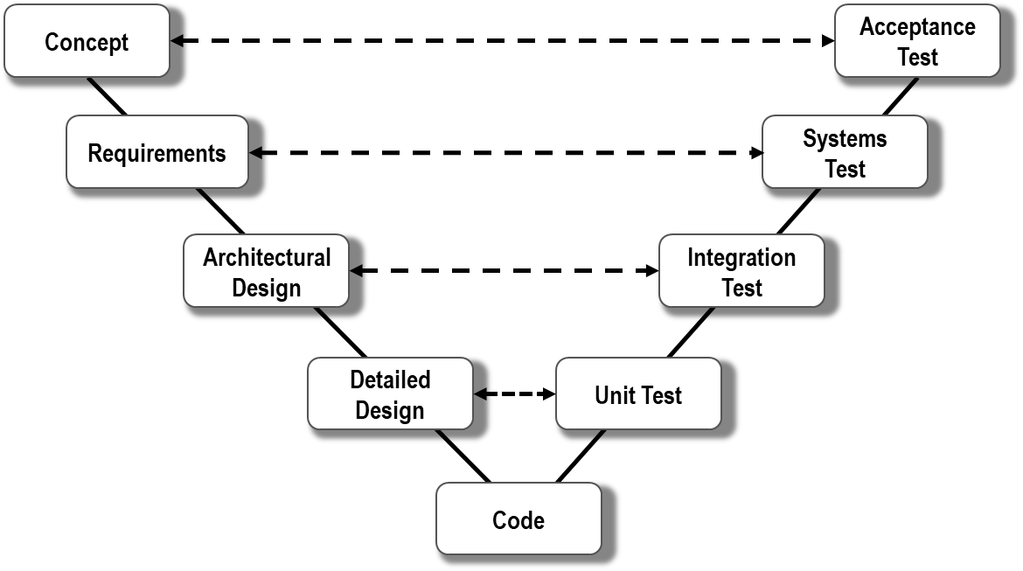
SDLC models and teams
The relationships between team structures and lifecycle models constrains the selection of both.
How you design your team will have an impact on the progress of the project.

Slide 8

Team design process
Match an SDLC with an appropriate team structure for the Language Research Case Study.
Consider the SDLC processes. (10 mins)
What SDLC process did you choose in tutorial two?
What are the key activities in this SDLC?

Slide 9
Team Structures
Consider the team structure (15 mins)
Identify key roles appropriate for the Case Study project.
Identify the contributions these roles will bring.
Decide on a structure of the team (e.g. centralized, decentralized, etc).
Controlled Centralised
Controlled Decentralised
Democratic Decentralised
Scrum Team

Slide 10

Link SDLC and team structure
Justification (10 mins)
a) What specific aspects of the Case Study Project support this combination of SDLC process and team structure?
b) What are the benefits of successful teams
c) List factors required by successful teams

Slide 11
Thank You!

